Slide 1
Cost of the Diet – Save the children

Slide 2
Challenge statement
Create an application that nutritionists can use on tablets (for the counselling of mothers on how to feed their children in developing countries)
Combines information (gathered through a UI from mothers regarding existing diets)
Providing a pictorial representation of the nutritional content of the diets
Show costs and comparisons
Suggest feasible nutrition recommendations

Slide 3
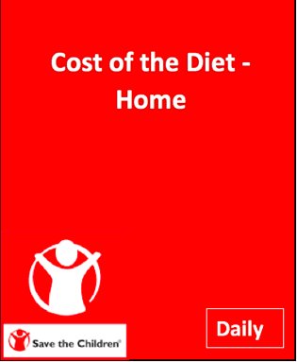
Aim of Application
Easy to use
Clearly shows mothers the effect of adding food items onto the cost of the overall diet and the nutrition provided to their child.

Slide 4
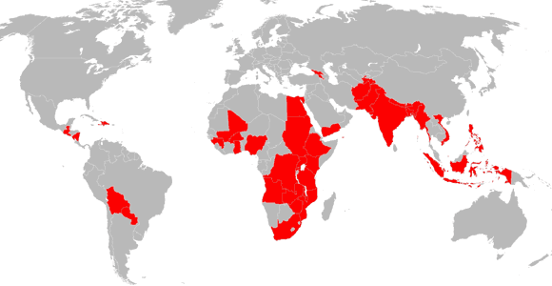
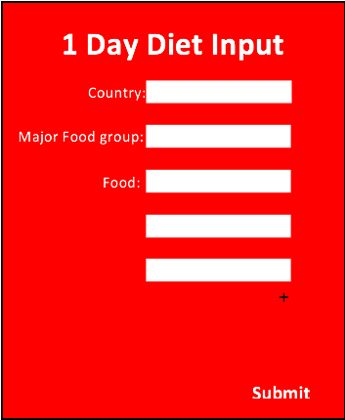
Implementation
1 Day Diet Input:
First specify the country.
Choose the major food group from a drop down box.
Search food in drop down box and repeat as many times as necessary.
Press submit when finished choosing.

Slide 5
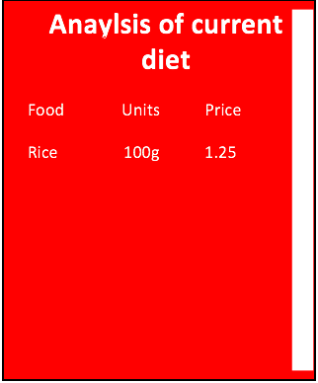
Analysis of current diet:
The data collection from the previous input is put into a table format.
This is a weeks worth of food.
This specifies the food type, units of food and the price.
Currency will depend on the country.

Slide 6
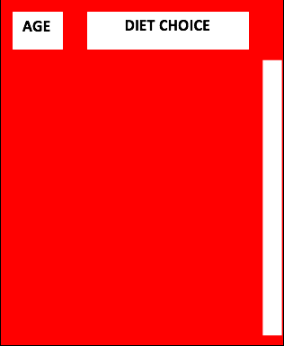
4 Varying Diet Types
Diet type:
Option to choose age and diet type for mother/family.
Showing recommendations depending on the diet chosen.

Slide 7
Application..
Effective tool to produce the outcome needed in the most simple way.
Developing countries: language barrier, less educated, so application needs to be easy to understand so that they can communicate well and advise the mothers.
Tablets – use of android.. more compatible and cheaper, so more readily available for the charity.

